Slide 1
ETSI Software Development Groups
Collaborative Software in Support of Standardisation

Slide 2


ETSI is adapting to a new software driven world
+ Software in Networks
ETSI SDG
Software Development Groups
+ Software in Standards
+ Software in Research
2

Slide 3



ETSI Software Development Groups
  Type of group in ETSI Directives since December 2022
      Tailored for collaborative software development, in support of standardisation
      Choice of software license, including open source
      Open communities, meritocracy-based governance
3
Notes:
Silvia
Tailored for collaborative software development
Tools, processes, governance, meritocracy
Free to develop their work programme, roadmap, scope
Choice of license, including open source
Open Communities
Open to ETSI members, non member organisations, individual contributors, users
Participation is free for ETSI members, SMEs, MEs, Universities, Public Research bodies, User/Trade Associations, and Individuals
Creating a new SDG only requires the support of 4 ETSI members, and motivating “Why ETSI?”

Slide 4
What is in it for ETSI
A TOOLBOX for quick prototyping, experimentation and new use-case validation allowing ETSI groups working on future network technologies to accelerate standardisation cycles and optimize their quality.
A BRIDGE between Standardisation and Research, as the code is adopted by research projects and new contributions received.
A VEHICLE to promote and facilitate adoption of ETSI standards among software development communities and open source projects.

Slide 5







Creating a new SDG
FM + ETSI Secretariat prepare a formal SDG Proposal
ETSI D-G discusses SDG Proposal with ETSI Board
4+ ETSI members (Founding Members)
+ idea
Pre-evaluation by ETSI Secretariat
SDG
Kick-off Meeting
SDG creation approval
SDG Announcement
T T + 1m T + 3-4 m T + 4-5m T + 6-7m
Initial period is 2 years, renewable.
Open to ETSI members, non‑members and individuals

Slide 6

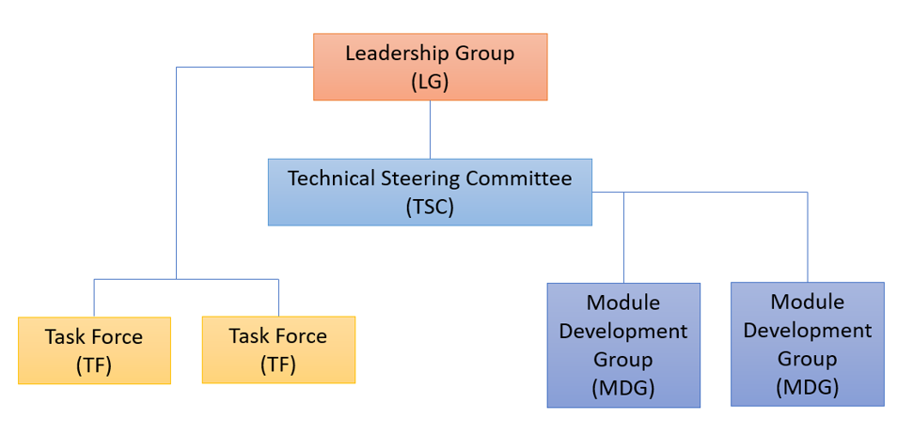



SDG Governance & Decision Making
Chair and
Vice-Chairs
ETSI Directives
Technical
Working Procedures
SDG Detailed Working Procedures
Top
Contributors
Meritocracy

Slide 7


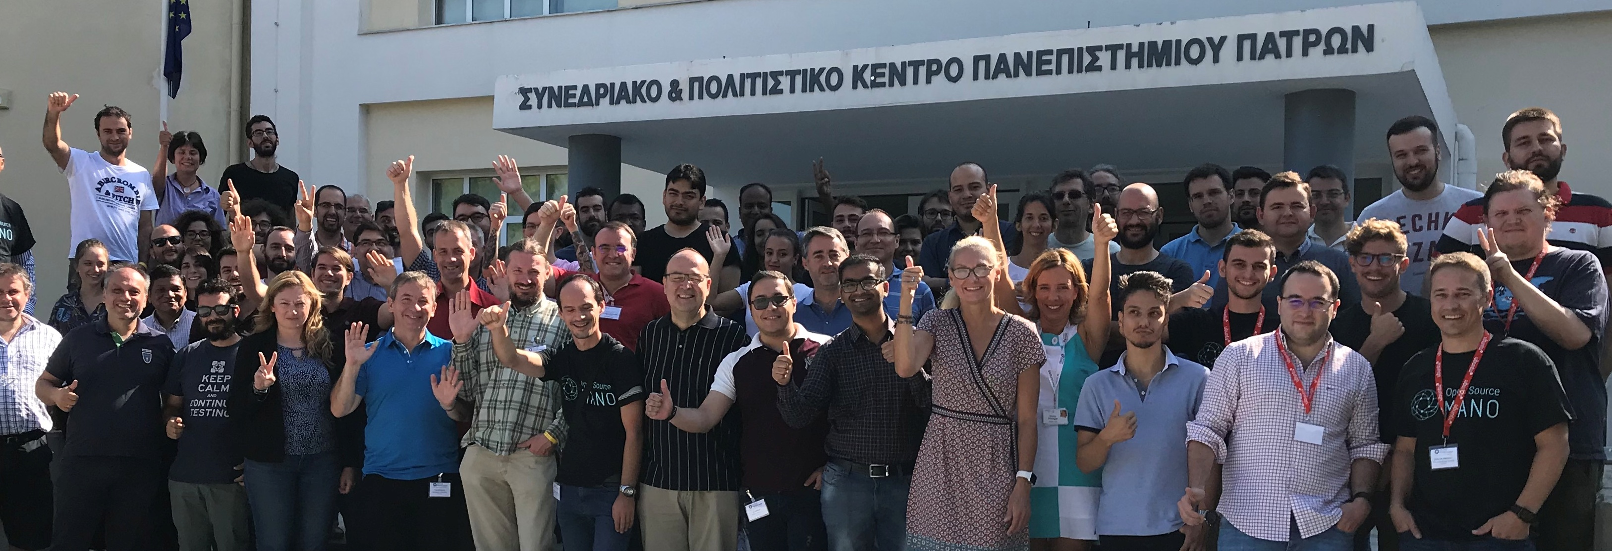
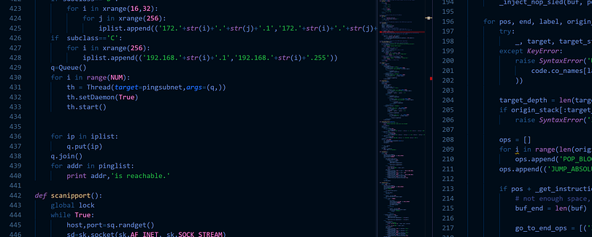
SDG Way of Working
SDGs develop code, not standards, but
  They provide regular feedback to standardisation groups (joint workshops, contributions..)
Most of the hard work (code) is done asynchronously & online (Gitlab, Slack, ..), but
  Community meets regularly (weekly conf calls / 2+ Plenary meetings a year)
Major code releases twice a year
  Followed by Plenary meetings, Hackfests, Webinars, demos, external events…

Slide 8
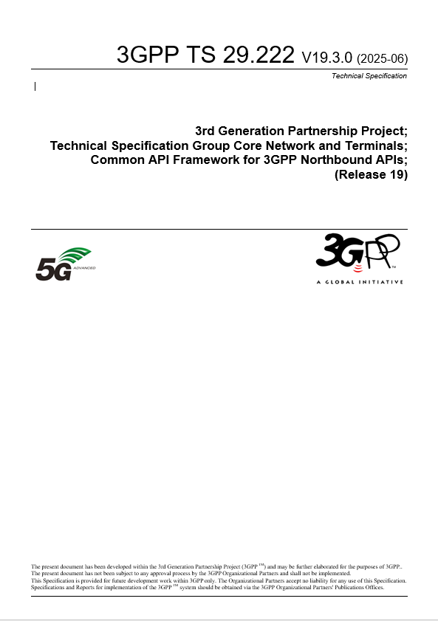
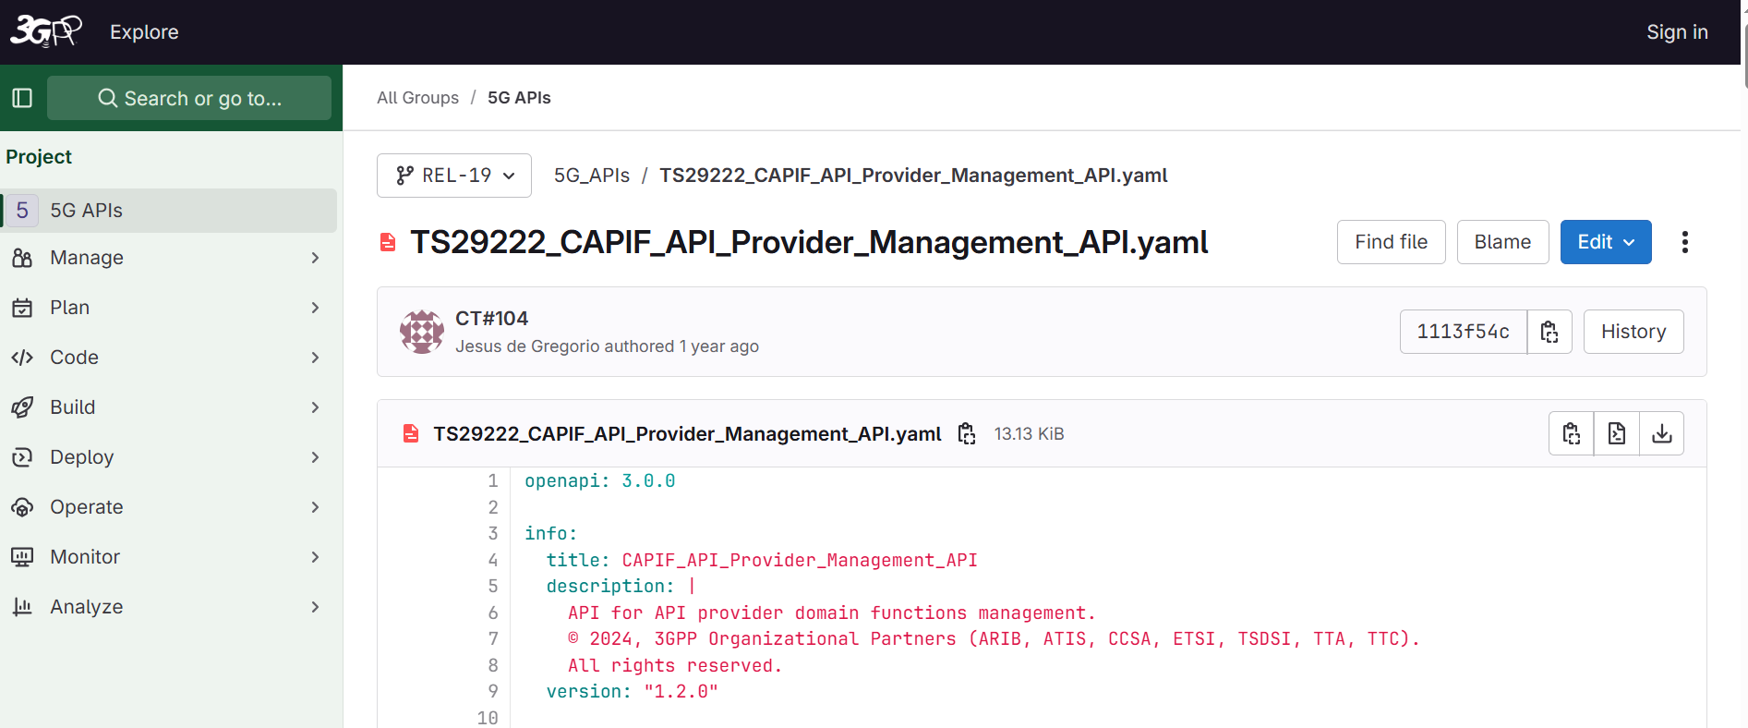

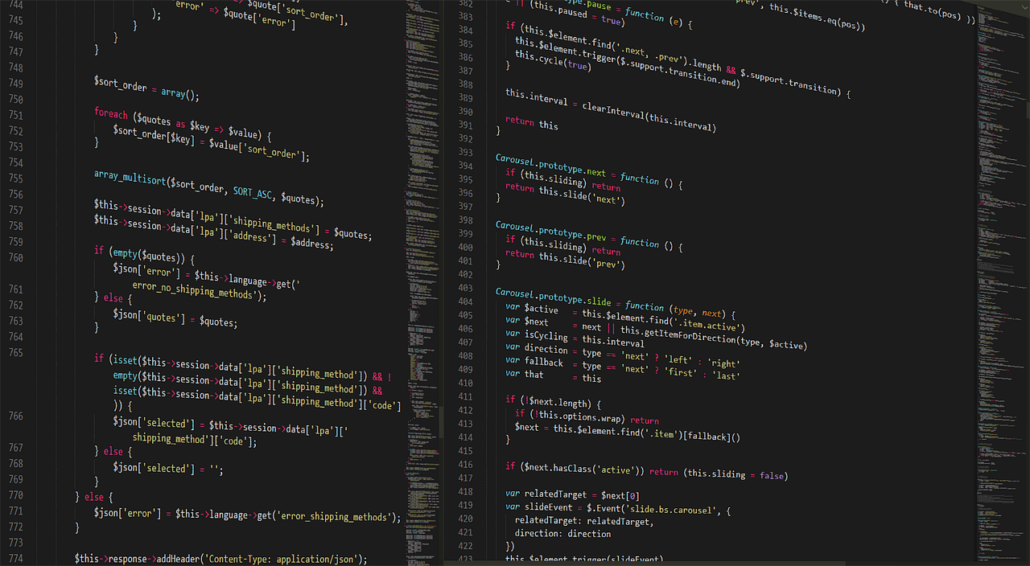
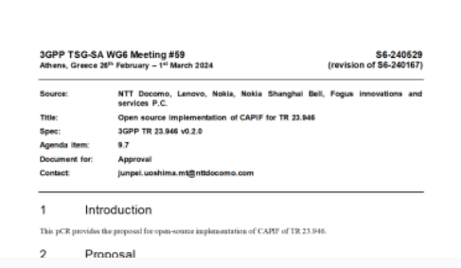
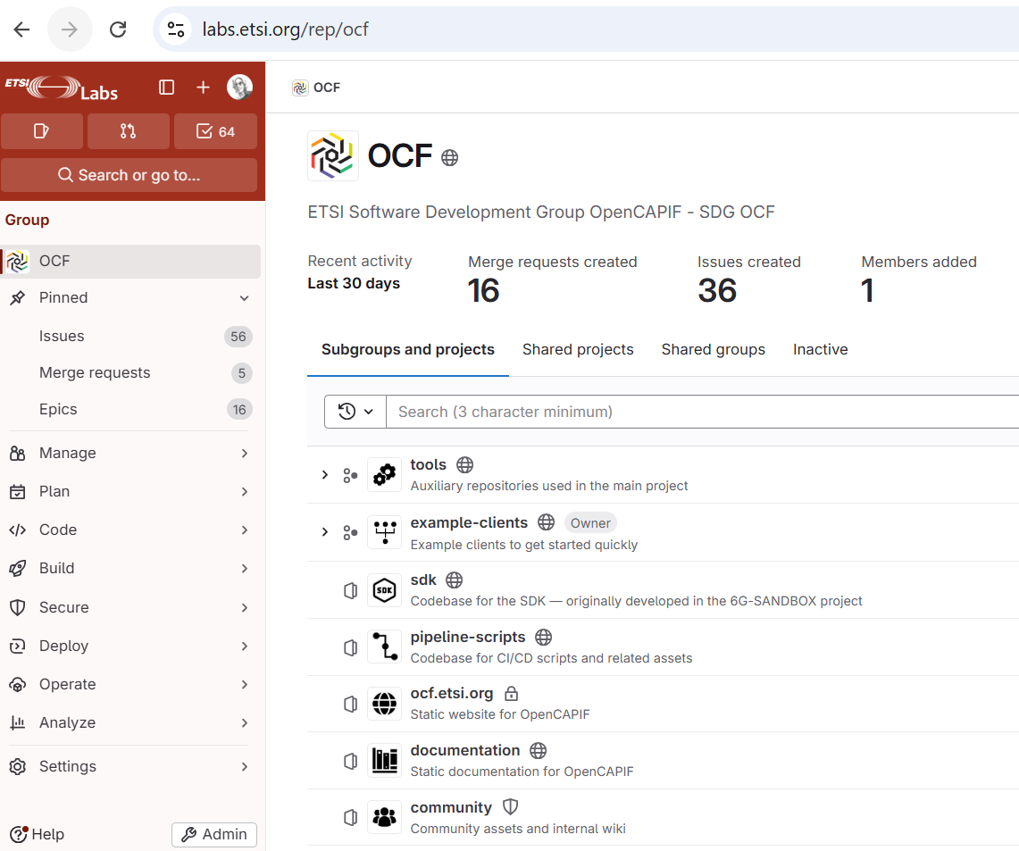
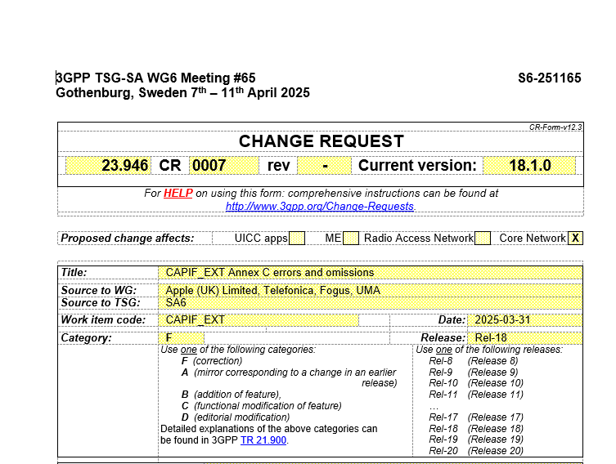
SDGs in support of Standardisation
SDG
TC / ISG / SDO

Slide 9

Zooming out…
Research Ecosystem
Integration,
Testing, PoCs
Plugtests
TC / ISG / SDO
SDG
External Open Source Communities

Slide 10














Open Source at ETSI - Timeline
Feb
2016
Jan
2024
Dec 2022
July 2025
2026+
SDG
Jun 2022
Oct 2023
Jun 2024
Jun 2026
SDG in ETSI Directives TWP

Slide 11
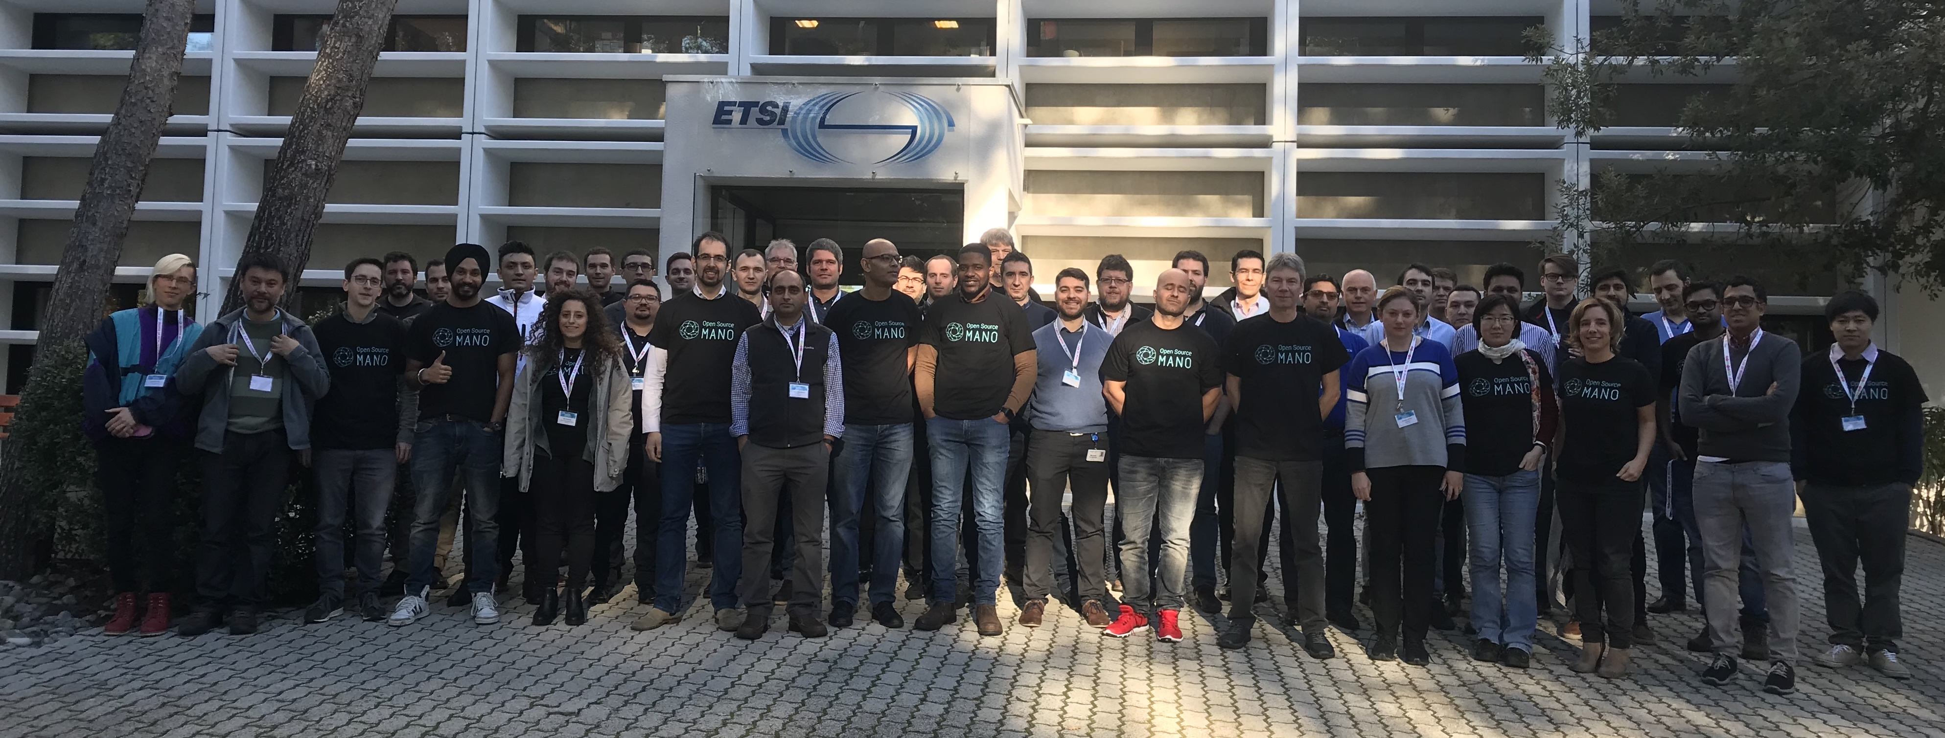
Open Source MANO
  Develops an open source Management and Orchestration Stack for Network Services across cloud platforms
  Created as (experimental) OSG in 2016
    Became an SDG in June 2026
  Aligned with ETSI NFV specifications
    Integration with OpenStack, Kubernetes, Open Air Interface, OpenSlice and TeraFlowSDN
  SW License: Apache License 2.0
https://osm.etsi.org
11

Slide 12























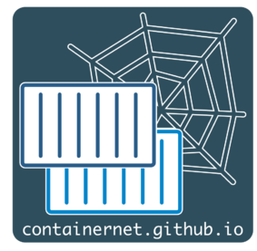































The SDG Open Source MANO Ecosystem
Specifications
Research
Open Source
Partnerships
12

Slide 13
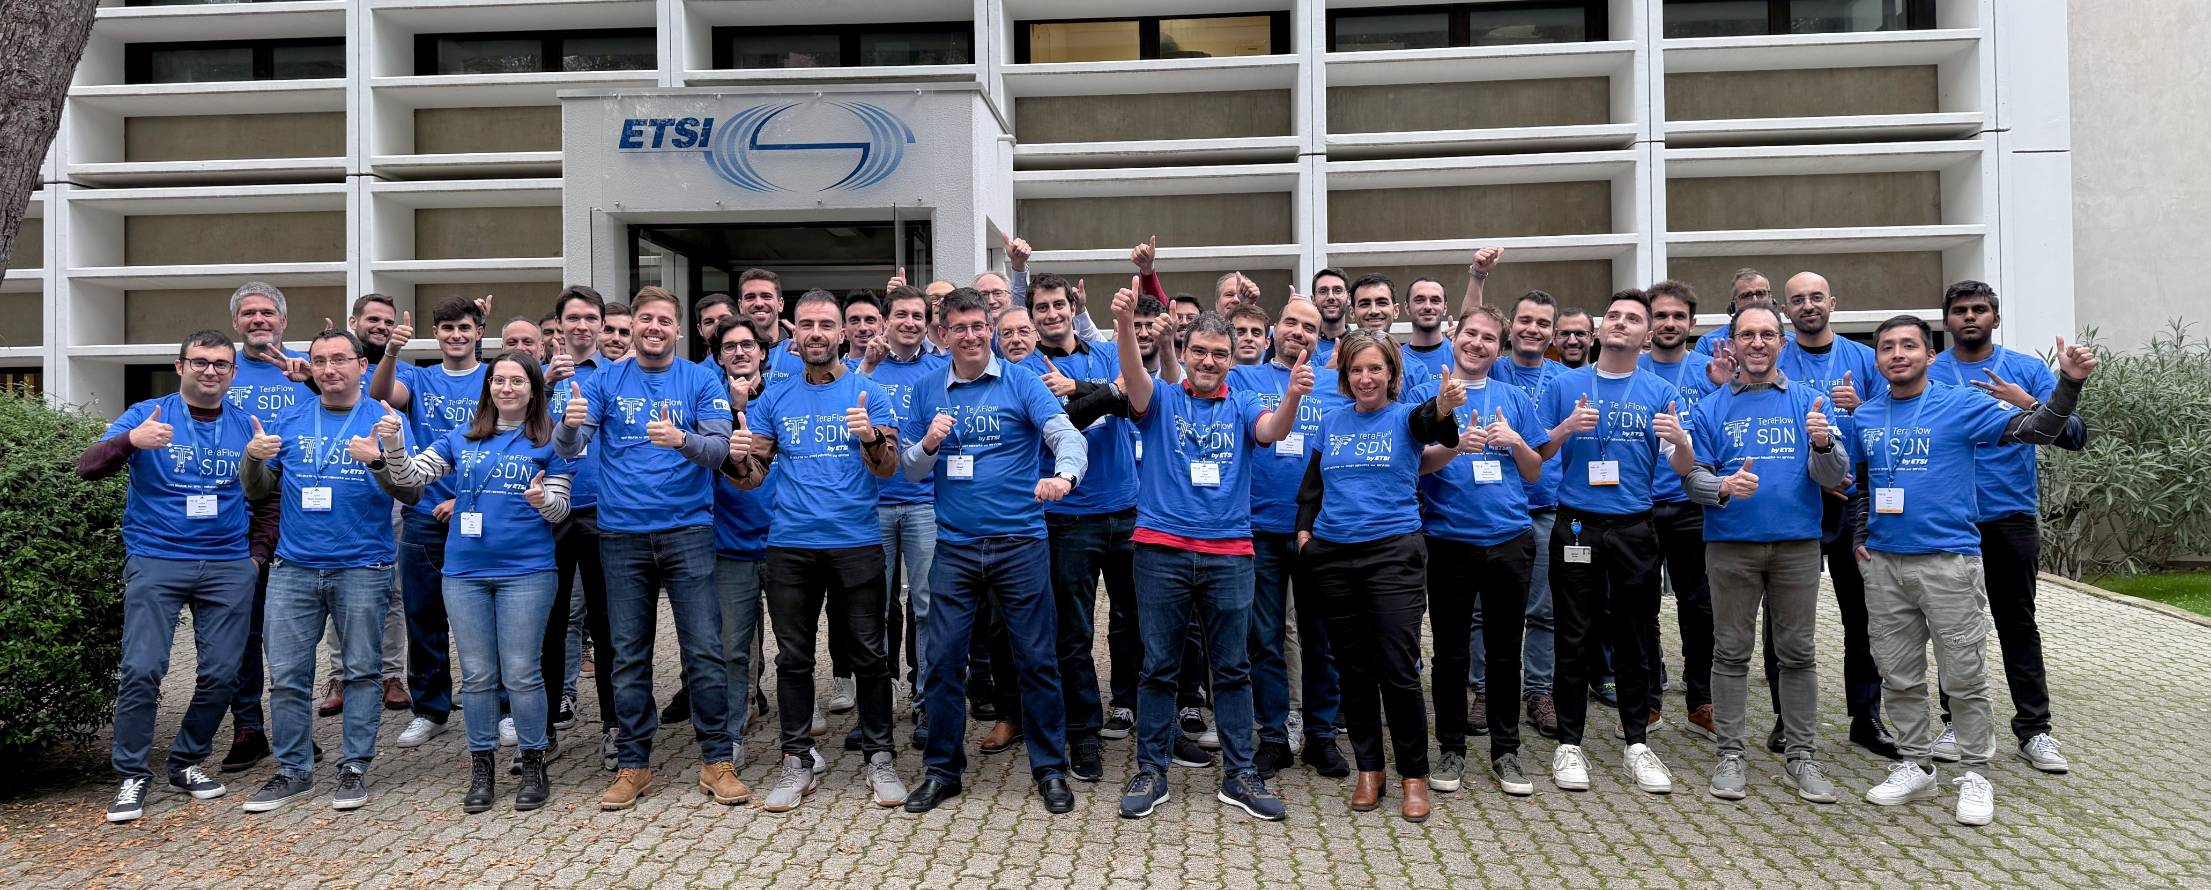
TeraFlowSDN
  Develops an open source cloud native SDN Controller enabling smart connectivity services, automation and security for future networks
  Created as (experimental) OSG in 2022
    Became an SDG in 2024
  Aligned with IETF, ETSI ISG NFV, MEC, ZSM, F5G, QKD
    Integration with Open Source MANO, OpenSlice
  SW License: Apache License 2.0
https://tfs.etsi.org

Slide 14




















The SDG TeraFlowSDN Ecosystem
Specifications
Research
Open Source
Partnerships
14
Notes:
Create mutual awareness
Leverage each other strengths
Support SDG demos and showcases
Hosted by ETSI, accessible by the different communities from wherever they are
Go further (and solve more complex problems) if we do it together

Slide 15
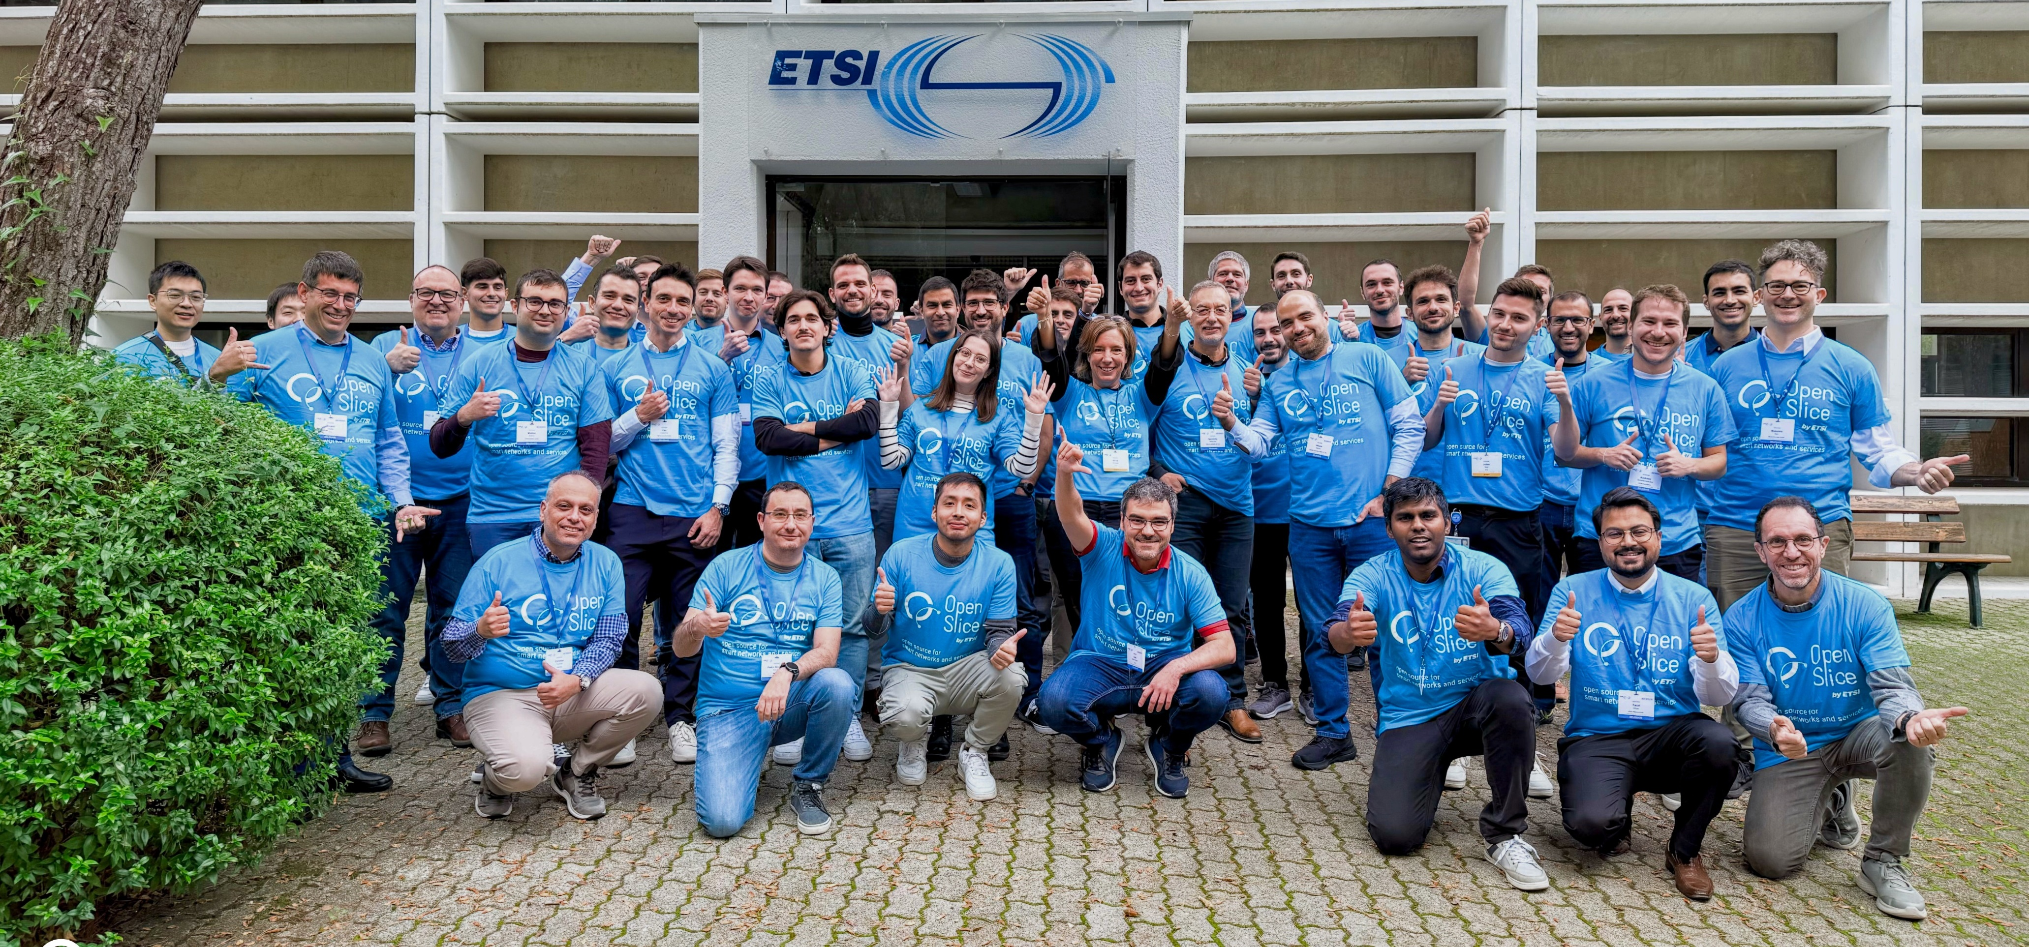
OpenSlice
  Develops an open source Operations Support System to deliver Network as a Service (NaaS)
  Since October 2023
  Aligned with ETSI ISG NFV, ZSM, TM Forum, GSMA and 3GPP principles and specs
    Integration with LF Sylva, Open Source MANO, TeraFlowSDN, OpenCAPIF, CAMARA
  SW License: Apache License 2.0
https://osl.etsi.org

Slide 16















The SDG OpenSlice Ecosystem
Specifications
Research
Open Source
Partnerships

Slide 17
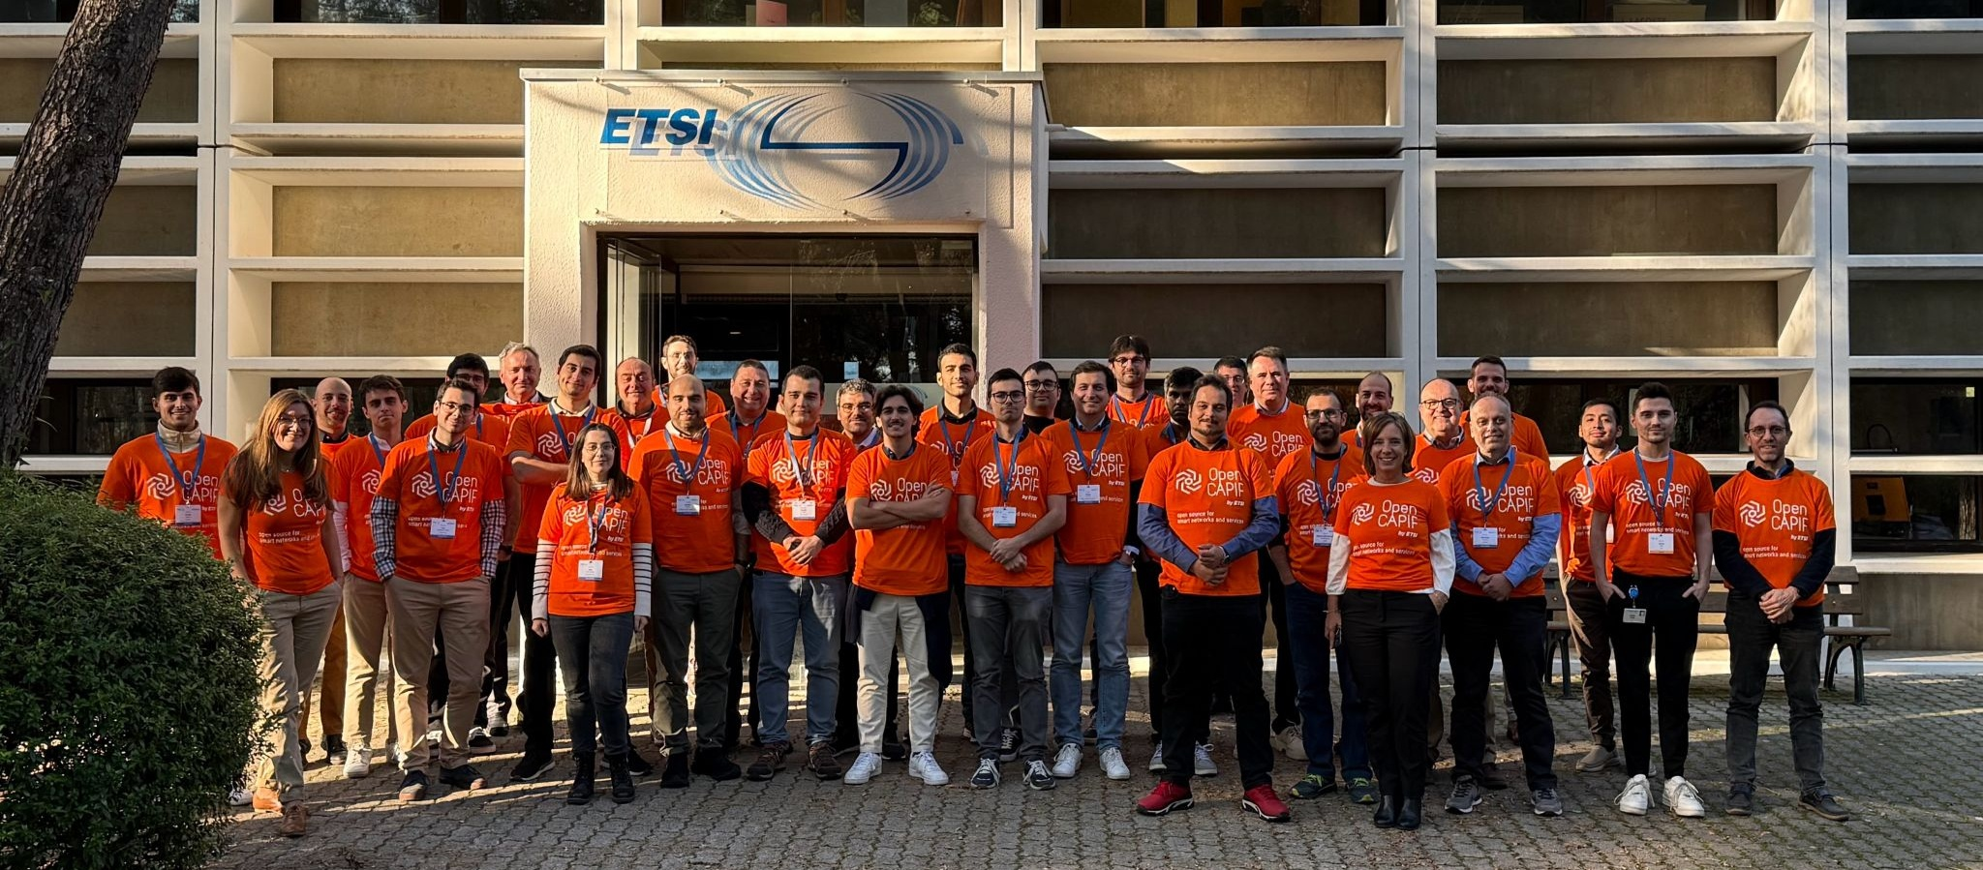
OpenCAPIF
  Develops an open source Common API Framework (CAPIF) as defined by 3GPP allowing to expose and invoke APIs in a secure and consistent way
  Since January 2024
  Aligned and contributing to 3GPP, ETSI MEC
  SW License: Apache License 2.0
https://ocf.etsi.org
Notes:
Silvia

Slide 18















The SDG OpenCAPIF Ecosystem
Specifications
Research
API Providers
API Invokers
Open Source
Partnerships

Slide 19

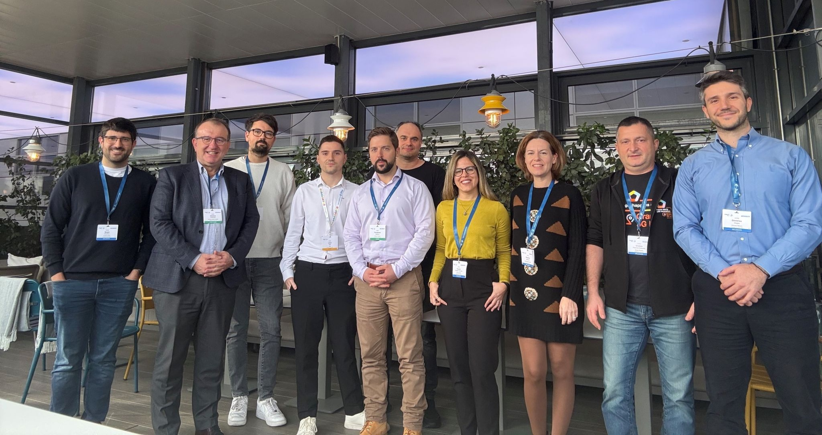
OpenOP
  Develops an Open Operator Platform allowing for network and testbed federation and capability exposure to support 5G/6G experimentation.
  Since July 2025
    Aligned with GSMA OPG specifications
    Exposing LF CAMARA APIs
    Consuming 3GPP, ETSI MEC APIs
  SW License: Apache License 2.0
https://oop.etsi.org
Notes:
Silvia

Slide 20






The SDG OpenOP Ecosystem
Specifications
Research
Open Source
Partnerships

Slide 21
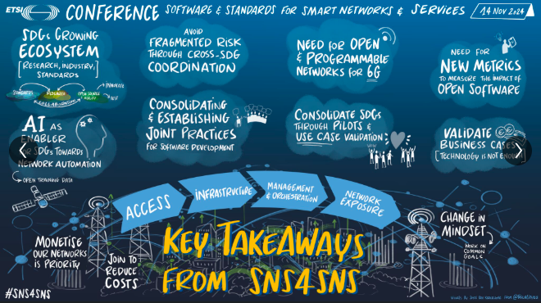
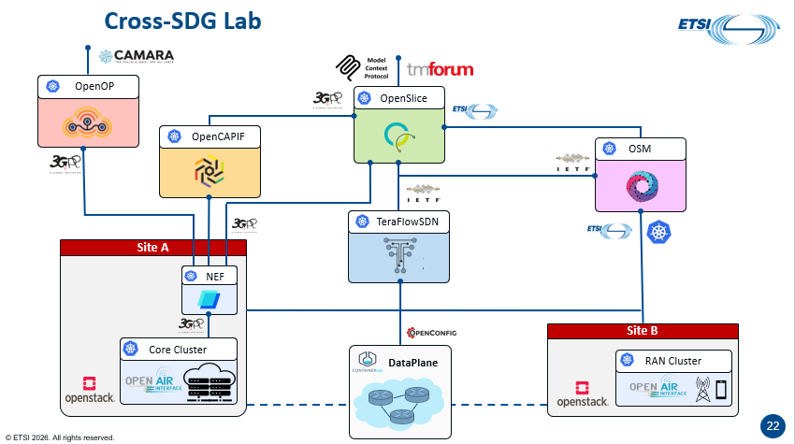
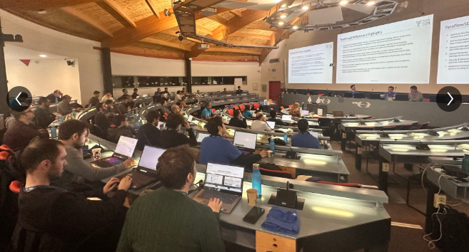
Cross-SDG Activities & Events
  Cross SDG Labs & Demos
  Joint SDG Ecosystem Days
  ETSI SNS4SNS
  EuCNC & 6G Summit
  Network X

Slide 22


How to get started with ETSI SDGs
As an individual
As an organisation
  Download the code from https://labs.etsi.org/
  Read the documentation
  Join the Slack and ask questions
  Subscribe the INFO mailing list
  Participate in a Hackfest or Ecosystem Day
  How: Sign the SDG Agreement
    – yearly fees may apply (*)
  What: All the previous +
    Request an ETSI Online Account (EOL)
    Subscribe the SDG Mailing list
    Participate in Plenary meetings
    Link new features and contributions to a research project
    Get a research project listed in SDG Ecosystem pages
    Apply for Module Leader positions
    Apply for TSC positions
    Apply for TSC Chair position
Who: Anyone
Who:
Non ETSI
Members
(Participants)
  How: Create an individual account at https://labs.etsi.org/signup/
  What: All the previous +
    Submit bug reports
Who: Individual
Users
  How: Accept the SDG ICLA and Upgrade your account to Individual Contributor at https://labs.etsi.org/manage/
  What: All the previous +
    Subscribe the TECH mailing list
    Participate to TECH Sessions / Conf Calls
    Contribute code and documentation
  How: Sign the SDG Agreement
  What: All the previous +
    Apply for Leadership Group positions (Chair, Vice-Chair)
    Access to all ETSI TCs & ISGs
Who:
Individual
Contributors
Who:
ETSI Members
(*) fees waived for SMEs, Universities, Public Research Bodies and User & Trade Associations

Slide 23
Thank you!
ETSI SDG Support
SDGsupport@etsi.org
https://www.etsi.org/technologies/software-standards/
© ETSI 2026. All rights reserved.

