Slide 1

Module 6 – 3GPP

Slide 2


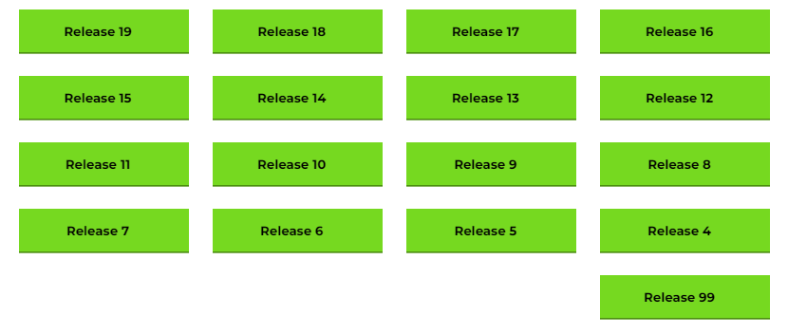

3GPP
Create the standards for 3G, 4G, 5G and starting on 6G
Releases (roughly every 18 months)
Specifications created by single 3GPP​
Adopted by each partner organisation to become standards
Administration hosted by ETSI in South of France
Technical meetings move around the world
A release is a consistent set of specifications

Slide 3
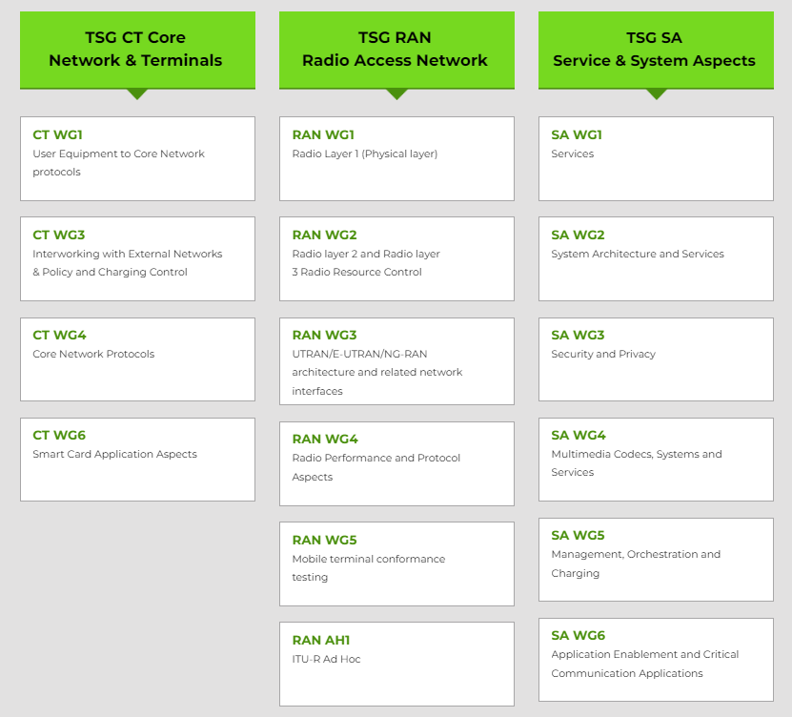
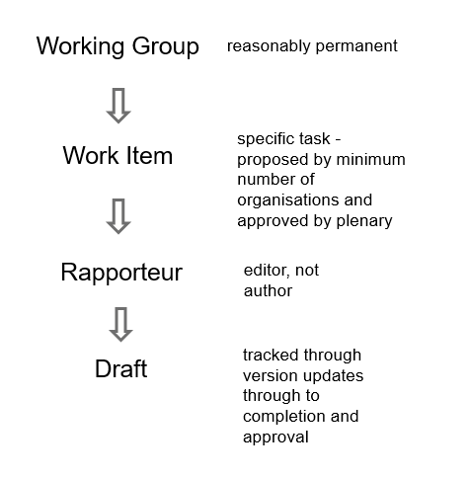
3GPP working groups and work items

Slide 4
3GPP Membership
These are organisations not people
ETSI members pay an additional fee to attend face-to-face meetings
Total membership = 818 (857)
 | TSG#110 | TSG#111
ETSI | 459 | 446
ATIS | 87 | 82
ARIB | 28 | 28
TTC | 13 | 13
CCSA | 176 | 168
TTA | 37 | 32
TSDSI | 57 | 49
Total | 857 | 818
Guests = 29 (51)
Europe
North America
Asia
Reduced number of members ☹
Data of 05/03/2026

Slide 5
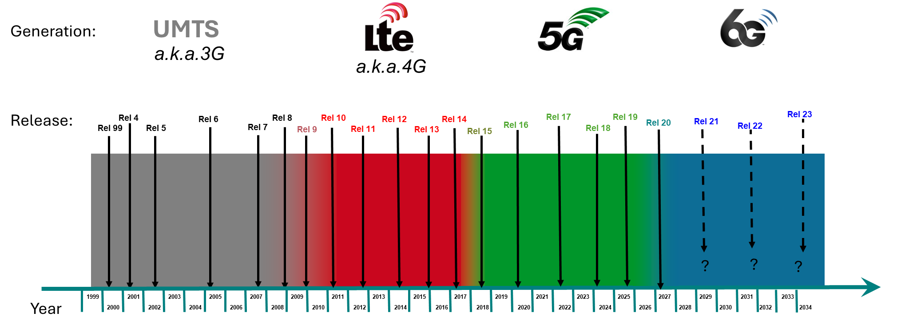
Don’t get frightened by the numbers
OK they are big
Release 16 has 165,745 pages
They cover everything from the air interface to the core network protocol
Easy to find on https://www.3gpp.org/specifications-technologies/specifications-by-series
Open and free to download

Slide 6
Change Requests
As we saw in the last section, corrections and improvements can be made
A Change Request (CR) is used
These documents explain what is wrong and how it should be mended
Again, the numbers are big

Slide 7
Releases
2021
2022
2023
2024
2025
2026
TSGs
#91-e
#92-e
#93-e
#94-e
#95-e
#96
#97-e
#98e
#99
#100
#101
#102
#103
#104
#105
#106
#107
#108
#109
#110
#111
#112
#113
#114
Major changes are made in releases
4G and 5G cover more than one release
The definition of a G is made outside of 3GPP
A waterfall approach used
Stage 1 – requirements
Stage 2 – architecture
Stage 3 – detailed specs
Mar.
Jun.
Sep.
Dec.
Mar.
Jun.
Sep.
Dec.
Mar.
Jun.
Sep.
Dec.
Mar.
Jun.
Sep.
Dec.
Mar.
Jun.
Sep.
Dec.
Mar.
Jun.
Sep.
Dec.
SA1 Stage 1
RAN Content def.*
Stage 2 Normative
Release 18
RAN Completion**
Maint.*
Stage 3 (CT & SA)
ASN.1 & Open APIs
ASN.1
1st review
SA1 Stage 1
RAN Content Def*
SA St.2 Content Def
Release 19
Stage 2 Normative
RAN Completion**
Stage 3 (CT & SA)
ASN.1 & Open APIs

Slide 8








Overall 3GPP 6G Workplan
2024
Stage-1 workshop on IMT2030 use cases
WG SA1
Rotterdam, Netherland, May 8 – 10, 2024
SP-241391: SA1 6G study item on use cases and service requirements (FS_6G_REQ) approved at TSG SA#105.
First 3GPP TSG-wide 6G Workshop
To discuss vision & priorities for next generation RAN, system architecture,
CN and protocols.
TSGs#107
Incheon, S. Korea, March 10 – 11, 2025
from Release 20
    RP‑251881: The 6G RAN + RAN WGs Studies on 6G Radio was approved at TSG RAN#108
    See next slide for the 6G studies timelines
Studies for 6G
Release 21 is expected to produce the 1st set of 3GPP 6G technical specifications and will be the release for IMT-2030 submission before 2030 and is expected to be delivered with a single drop (i.e., a single code freeze).
Rel-21 timeline is to be decided no later than June 2026
However, ASN.1/OpenAPI freeze date is no earlier than Mar. 2029
from Release 21
Normative work for 6G
2030
Source: 3ORW-250002, 3GPP – ORAN ALLIANCE Joint Workshop on 6G, Sophia Antipolis, France, 24 -25 April 2025

Slide 9

Release 20: 6G Timeline
2024
2025
2026
2027
TSGs
#113
#114
#102
#103
#104
#105
#106
#107
#108
#109
#110
#111
#112
#115
#116
Dec.
Mar.
Jun.
Sep.
Dec.
Mar.
Jun.
Sep.
Dec.
Mar.
Jun.
Sep.
Dec.
Mar.
Jun
SA1 6G SID def.
SA1 6G Study
Workshop IMT-2030 use cases
RP IMT-2030 disc.
RP ITU Study
RP 6G Study
Workshop on 6G
SA2 & RAN WGs 6G SID def.
SA2 6G Study(ies)
or
SA3/4/5/6 SID def. and compl. TBD
RAN1 6G Study(ies)
RAN2/3/4 6G Study(ies)
Stage 3 6G SID def.
Stage 3 6G Study(ies)
TBD
IMT-2030 Technical Performance Requirements
Requirements, evaluation criteria and submission templates
Tech proposals
Workshop on technology proposals
Source: 3ORW-250002, 3GPP – ORAN ALLIANCE Joint Workshop on 6G, Sophia Antipolis, France, 24 -25 April 2025

Slide 10
Summary
Learn more about 3GPP on 3gpp.org
Watch the 5G introductory video - https://vimeo.com/manage/videos/790081425
Read a specification
Ask the phone salesperson which release of 5G is supported

Slide 11

Thank you for your attention
Follow us on:

