Slide 1
Module 5 – Let’s look at a standard

Slide 2
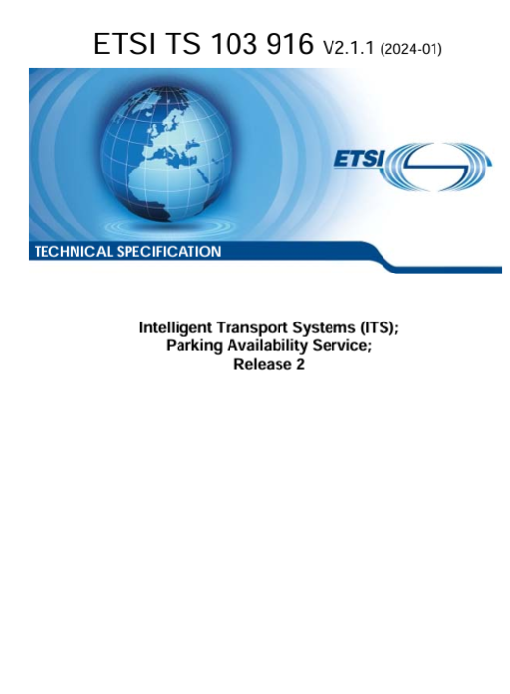
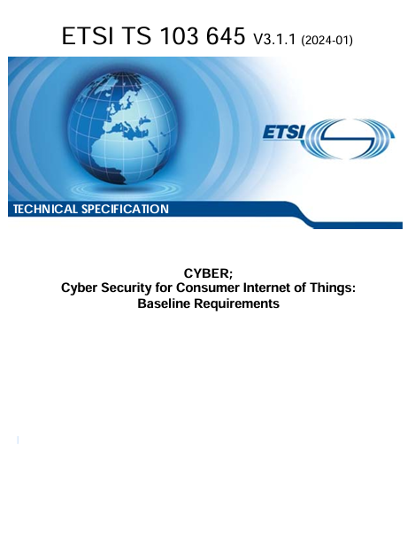
Section 5 – Real examples
Let us take a look at 2 ETSI standards
One for connected cars
One for Cyber Security
You can download them free of charge from the ETSI Website
https://www.etsi.org/deliver/etsi_ts/103900_103999/103916/02.01.01_60/ts_103916v020101p.pdf
https://www.etsi.org/deliver/etsi_ts/103600_103699/103645/03.01.01_60/ts_103645v030101p.pdf

Slide 3
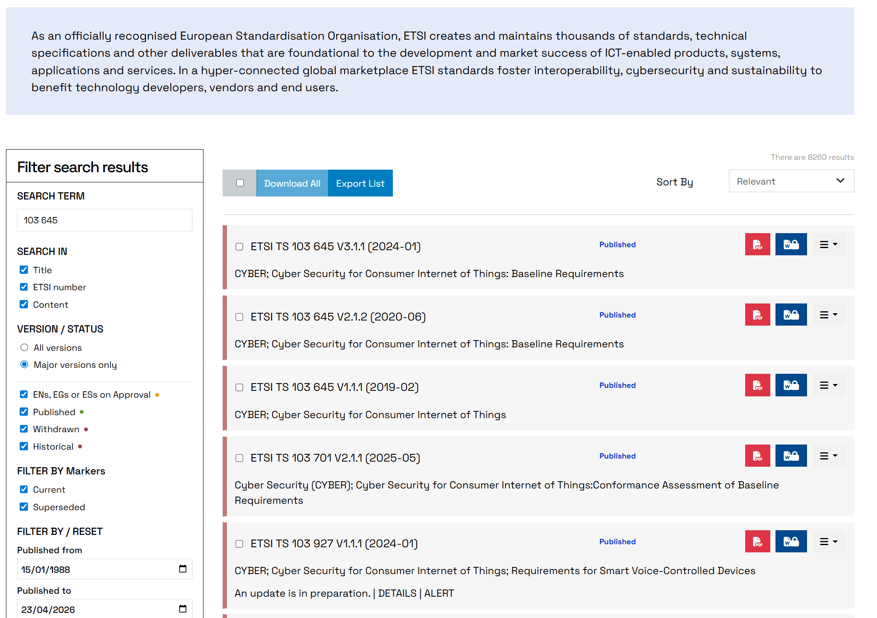
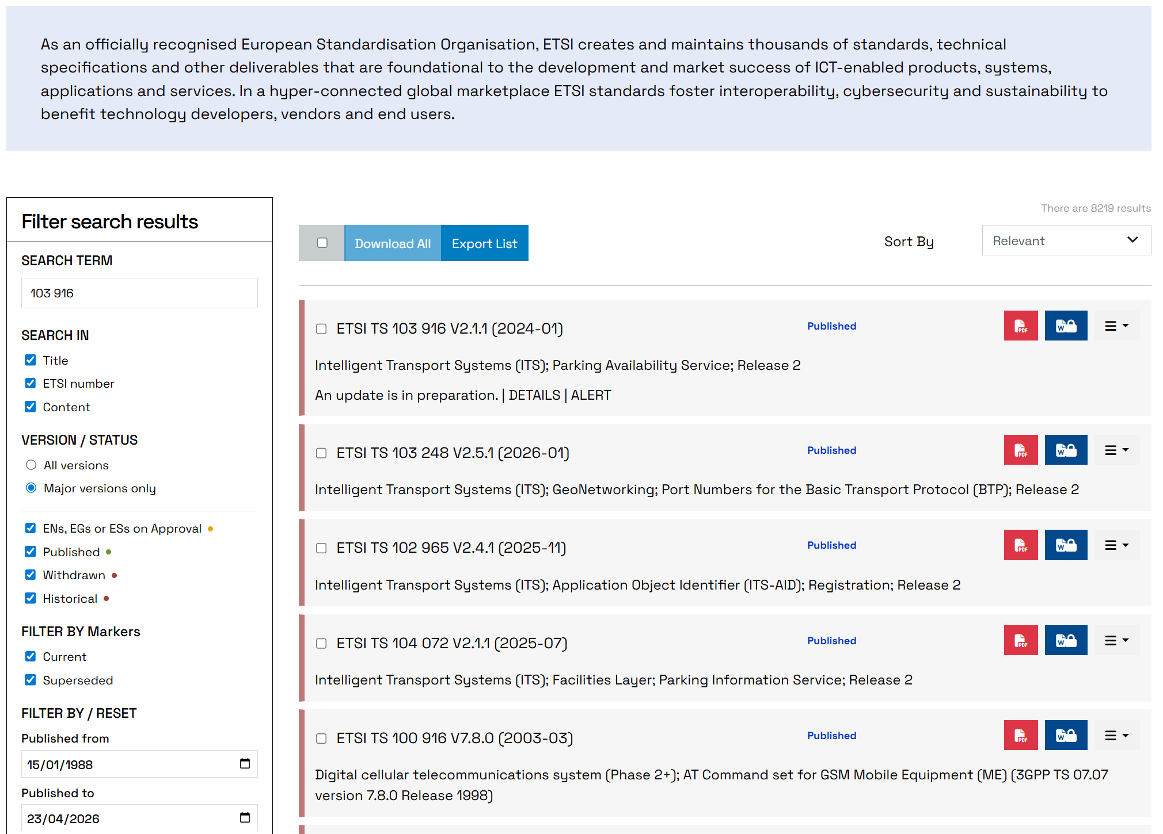
Search for standards on ETSI.ORG

Slide 4
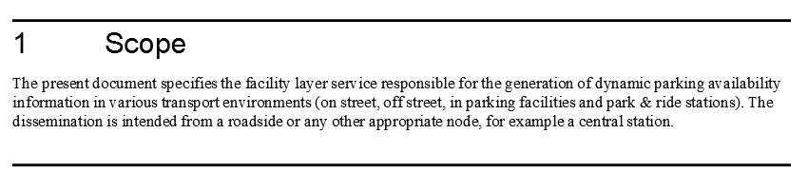
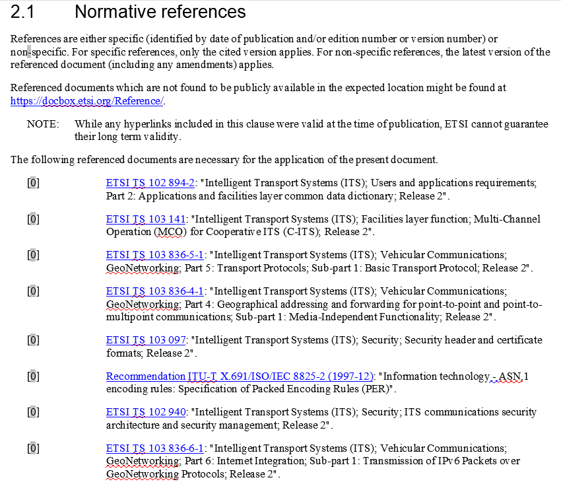
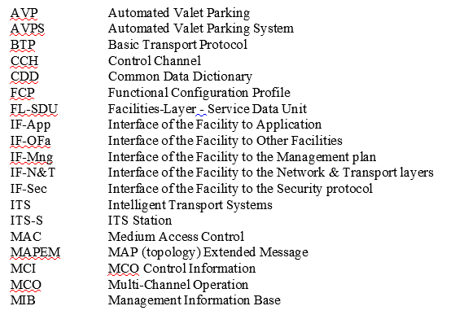

Connected car parking service
The scope tells us what the Specification is all about
The references tell us what else to read
And the long list of Abbreviations

Slide 5
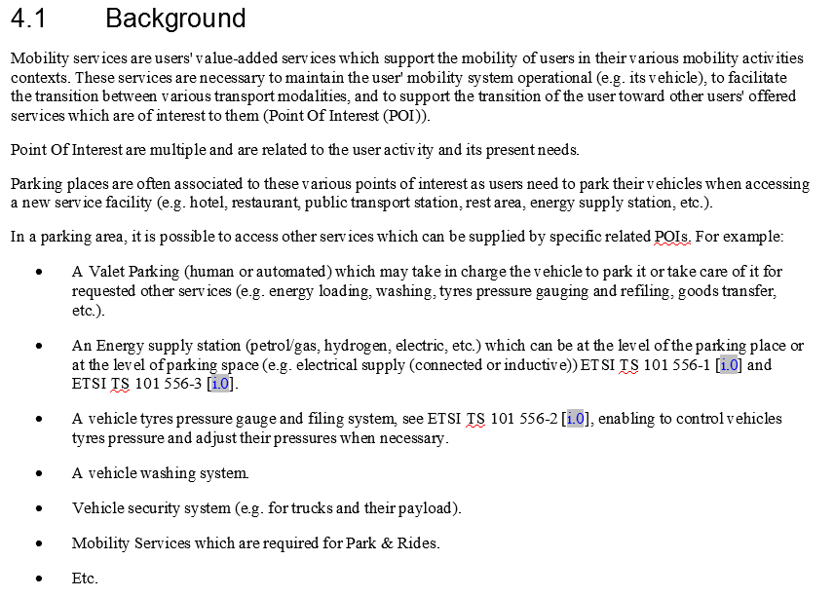
Informative information
Some sections provide background material
This is useful for understanding the more detailed normative sections

Slide 6
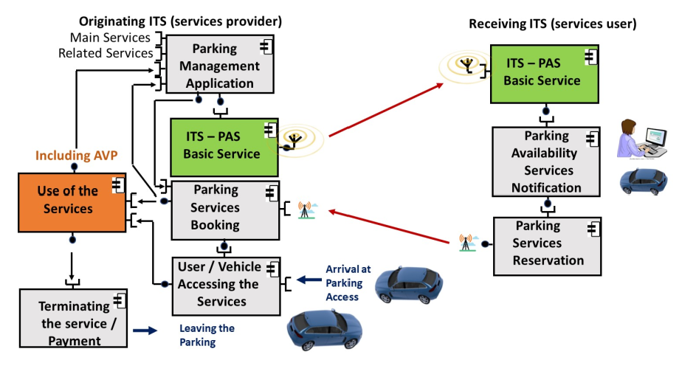
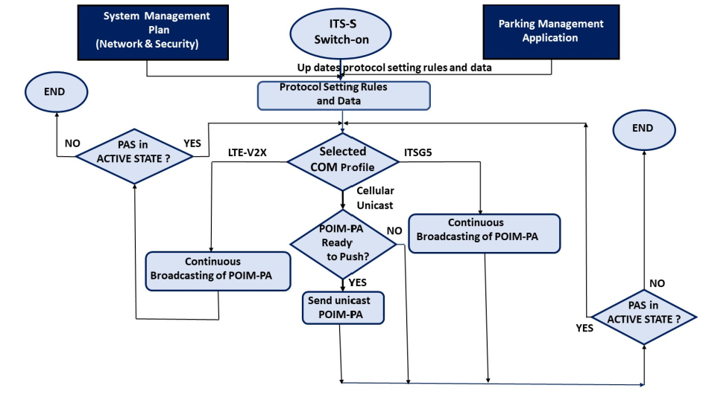
Diagrams
Diagrams can vary from high level overviews of the system to detailed flow charts
They are normally informative
Specifications are corrected over time but change control (track changes) on diagrams is harder than text

Slide 7
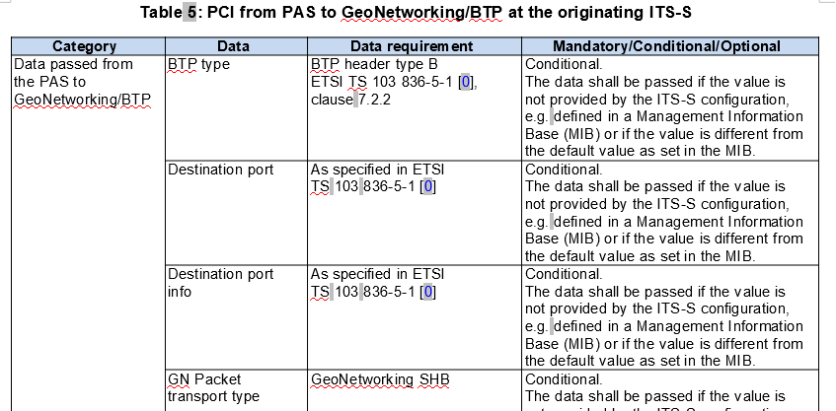
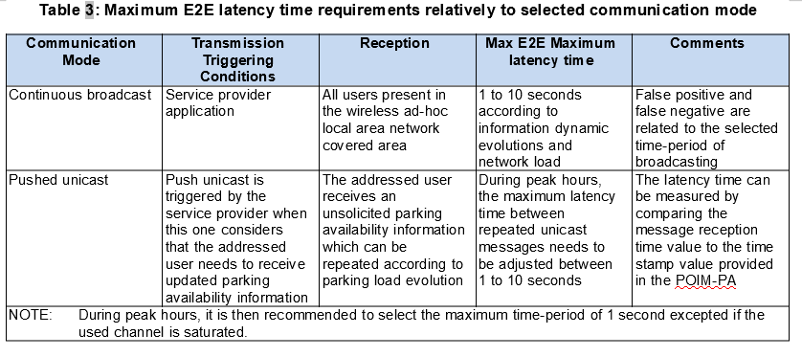
Tables
Tables are often used to describe parameters passed over interfaces
They also indicate if parameters are mandatory/conditional/optional
Normally normative – look at the words “shall” and specific requirements “Maximum Latency Time”

Slide 8
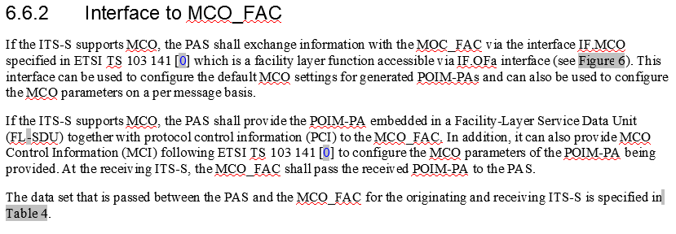
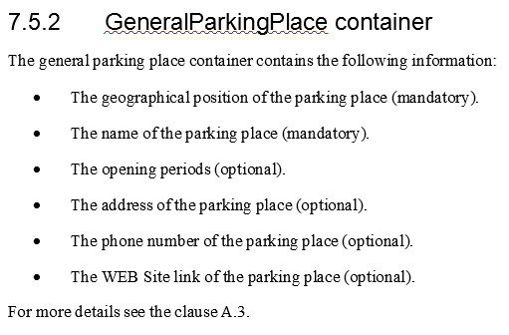
Text
In the majority of specifications requirements are written in text
Again, the magic words are used
“shall” a requirement you must comply with
“can” an optional requirement

Slide 9
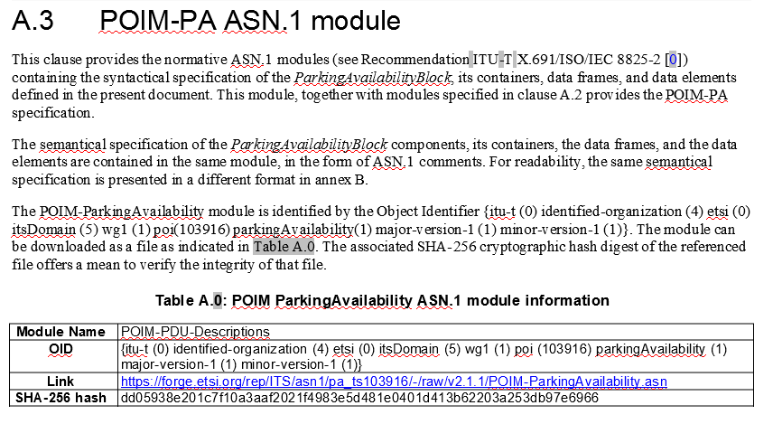
Annexes
Used for additional information
May be informative or normative
Here it points to machine readable versions of the standard
ASN.1 is a bit like code for protocols

Slide 10
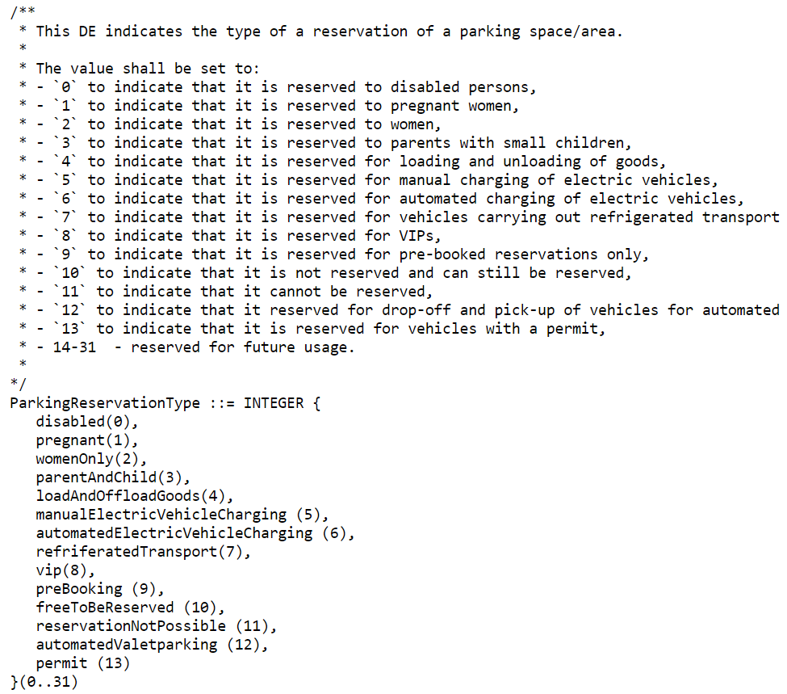
ETSI Forge - https://forge.etsi.org/
ETSI Forge is a platform where users of ETSI standards can download software produced collaboratively by ETSI delegates
It is home to machine readable versions of a specification
ASN.1 – the protocols that run over interface
OpenAPI – APIs to connect to services
Open source code
YAML - a data serialisation language

Slide 11
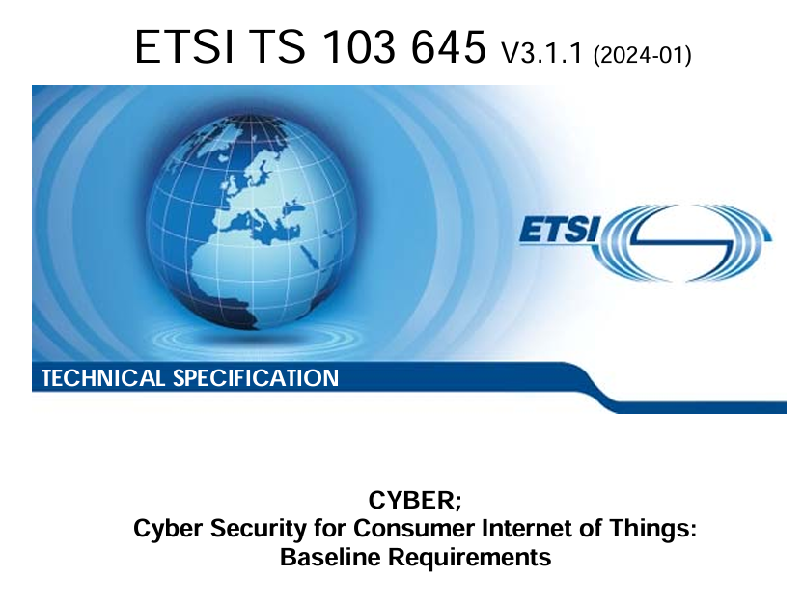
Version handling
Specifications change over time
A complex system of version numbers ensures you can get the latest version
Or an earlier version for reference
Functions are added in major releases
Corrections in minor releases

Slide 12
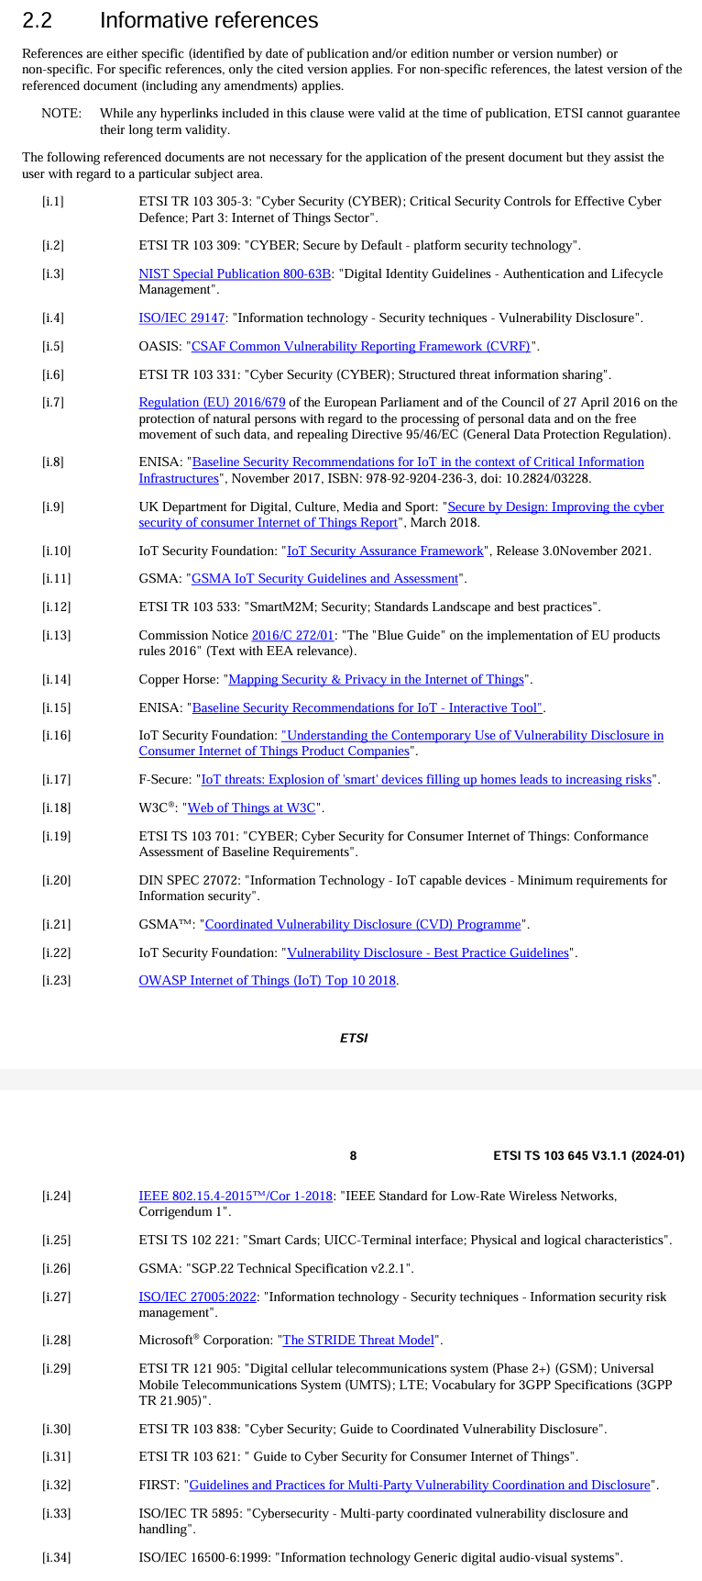
Informative references
A valuable source of information when starting to work in a new area
Many have hyperlinks to speed up the discovery process

Slide 13
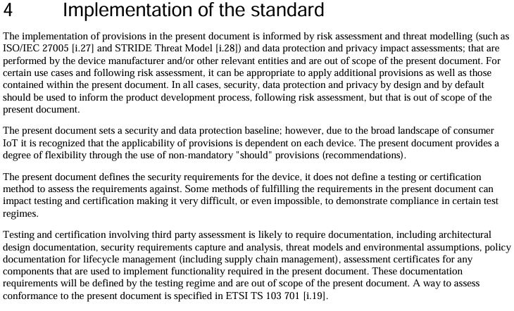
Testing and certification
Standards often have test specifications that help ensure compliance
ETSI does not perform certification testing
Specialist test organisations will help with both testing and certification
ETSI provides support on the application of testing and validation techniques in standards-making
https://www.etsi.org/about/our-expertise

Slide 14
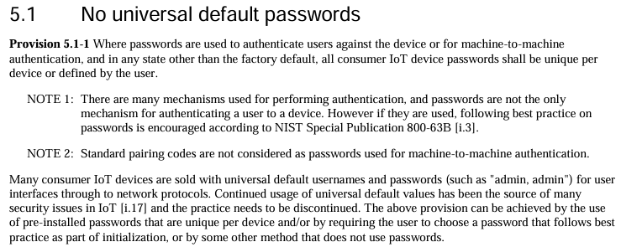
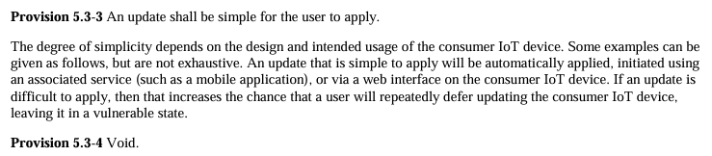
Defining requirements
Some requirements are easy to define
Think about how you would test it
Others are a lot harder
How would you test if something is simple?
You may see a few voids – these used to be requirements but have been removed – without affecting the following section numbers

Slide 15
Summary
The best way to learn how standards are written is to read a few
They are surprisingly interesting
Think of a topic you love and find a standard
If it is behind a paywall, check with your University Library
SDOs want to help. Go to the website and ask

Slide 16

Thank you for your attention
Follow us on:

