Slide 1
Roles in Standards
Thanks to Dr Milos Tesanovic for his inputs

Slide 2
Why consider standards as a career?
It can be perceived as ‘dry’, focused on specs rather than practical implementation, comprises a lot of travel, could be perceived as involving some tedious tasks e.g. word processing/spec revision/editorial tasks.
...but the reality is:
  You will develop a deep understanding of how certain technical and less technical decisions impact products.
  You will witness first-hand the transition from research to practice, and learn what type of research stands a chance of standards adoption and thereby real-world deployment.
  You will develop a wide range of skills beyond the technical ones – negotiation, consensus-building, advocacy, and an understanding of real-world constraints.
  You will learn not to take work-related decisions too personally – a form of detachment that is useful in many other areas of life.
  You will be part of a small group of highly skilled individuals, contributing to work that is crucial to the roll-out and widespread adoption of technologies at scale.

Slide 3
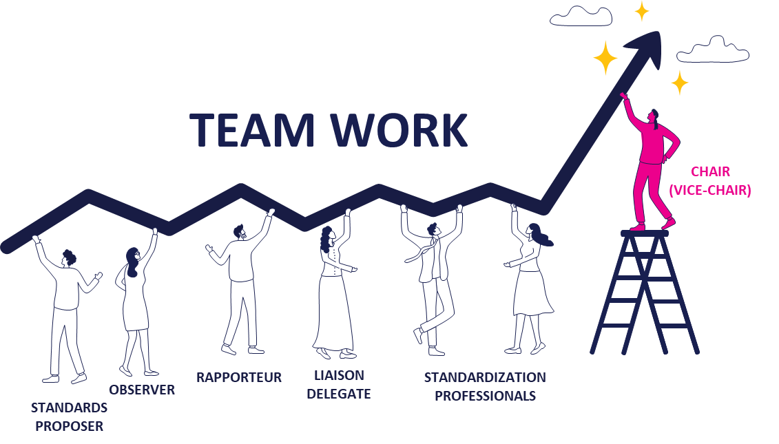
Main types of roles
Standards delegate
  Chair
  Vice-chair
  Rapporteur
Back-office standards engineer
Research engineer
Standards manager
Officer in an SDO

Slide 4
Standards delegate
Delegates are appointed by their respective member organisations.
Attends meetings of individual committees or bodies.
Presents and defends proposals, holds online and offline discussions with other committee members, pushes for a specific idea within the confines of the particular committee.
May on occasion be able to rely on back-office support (to draft documents, perform simulations if needed, etc.), or may need to carry out some or all of this work themselves.
The role may involve long hours during and in the run-up to meetings, as well as juggling multiple responsibilities (representing one’s own organisation and taking on roles within the committee, such as Chair, specification rapporteur, or discussion moderator).

Slide 5
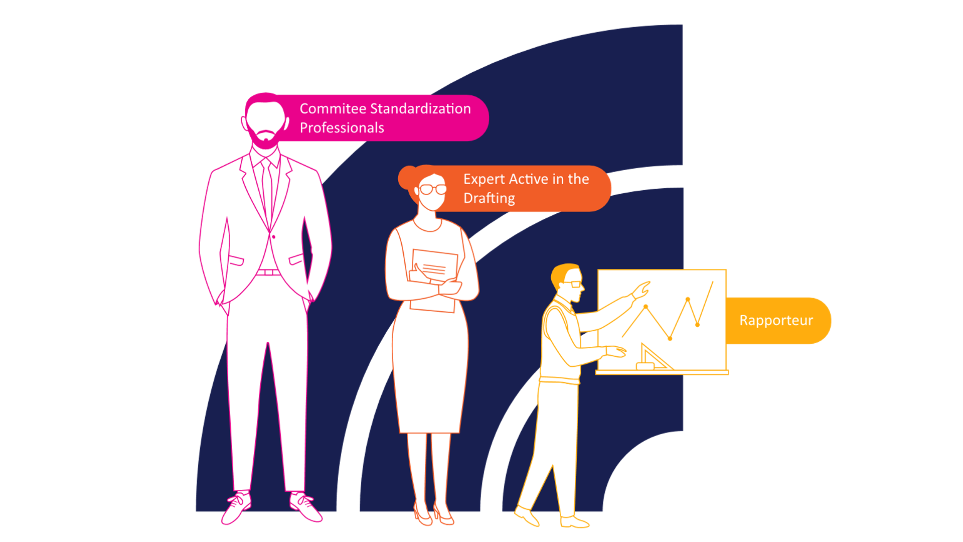
Roles within a committee
Chair
  Often a seasoned standards delegate.
  Ensures an efficient operation of the technical group in line with the ETSI Directives.
  Reports to the OCG, Board and the General Assembly on the activities of the Technical Group.
  Is impartial, - represents the ETSI committee, not their supporting company.
Vice Chair
  Supports the Chair, may replace the Chair in certain circumstances.
Rapporteur
  Ensures a Work item is delivered on time and respects the ETSI drafting rules.
  Encourages active participation of committee members.
  Edits the specification/report.
  Acts as the prime contact point on technical matters and for information on progress throughout the drafting phases.

Slide 6
Back-office standards engineer
Drafts standards documents (discussion papers, CRs etc.), performs simulations which demonstrate benefits of a particular solution or exposes a certain issue with the current systems.
May need to file patents to protect the intellectual property developed.
Needs to be well-versed with the specifications, to understand the release timeline, anticipate issues, and understand the positions of other companies.
Close links to relevant product departments.

Slide 7
Research engineer
Looking further ahead e.g. new technologies, towards the next ‘G’, or a new feature in a future Release.
Less constrained by standards bodies’ regulations, but more constrained than a researcher in academia (usually, not always).
Compared to peers in academia, is (typically) more aware of patents and related procedures.
More likely to consult and publish academic papers than a standards delegate or back-office standards engineer, but usually with focus on specific product idea or future standard.

Slide 8
Standards manager
Managing a team working on standards is a highly specialised management job, requiring deep understanding of the standardisation process, the technical details (not always at the same deep level as their team) across multiple Working Groups or committees.
Needs to be skilled at managing the distinctive mix of people who work in standards.
Needs to recognise standards-related potential in candidates and deliver role-specific onboarding.
Requires understanding of business aspects, including liaising with business units.

Slide 9
Officer in an SDO
Perhaps the least technical, but most specialised of the roles.
Often requires an engineering background but does not typically involve the development of new technology.
Instead, they focus on the operational management of technical committees, supporting the Chair during meetings, maintaining specifications, implementing agreed changes, producing new versions, and overseeing release timelines.
It requires a higher degree of IT knowledge and project management skills than other roles mentioned here.

Slide 10
How to go about becoming a standards engineer
A strong degree in Electrical Engineering or Computer Science is a good start.
  Advanced degrees help but are not a requirement, especially for more “engineering” type of standards work (e.g. protocols – as opposed to more “research-y” topics, say, PHY layer).
Typical employers are major OEMs and operators, alongside an increasing number of satellite companies and specialised SMEs.
Some practical experience via internships is highly valued – standards work entails a high degree of real-life constraints and, as such, may represent a challenge for someone fresh out of university.
  Understanding of underlying trade-offs, giving up on a search for “optimal” solution in favour of a pragmatic approach, awareness of various processes (and how they could be used to your advantage) rather than focus only on technical know-how.

Slide 11
Skills to focus on not (typically) part of regular curricula
Knowledge of regulatory frameworks.
Negotiation skills, influence, advocacy.
  Difference between being right, and doing the right thing.
  Learning to choose your battles.
  Some wins erode relationships – be mindful of that.
Business impacts of technical decisions – optimal in a mathematical sense does not mean the most successful in terms of the wider ecosystem.
Knowledge about Intellectual property.

Slide 12
Skill mix varies depending on the employer
Operators will focus on use-cases and business models, aiming to maximize their income, looking for new opportunities (e.g. how to use data being collected), achieve reductions in cost, effect coverage improvements.
Terminal vendors will focus on minimizing terminal complexity (and of course resulting cost), extending battery life, protecting own data, minimizing number of test cases.
Network vendors will focus on tighter control of terminal behaviour, increased feedback from terminals, and greater operational flexibility.
New entrants may have a specific technology (e.g. a new waveform, a new positioning algorithm, a new use-case) which they would like standardised to ensure wider adoption of their proprietary technology.
... There is usually no single ‘best’ solution for a technical problem – the different participants in the standardisation process often have different goals
  Overall success of each particular technology (e.g. 6G) is of course a shared goal.

Slide 13
Importance of ‘soft’ skills in the age of AI
Engineers like to focus on “hard” skills and what is conventionally perceived as demonstrable through practical tests, such as programming, advanced maths, circuit design, data analysis.
  Acquisition and assessment of these skills is often short-term focused.
Could GenAI replace some of these tasks at a fraction of the cost?
People and management skills — working well in teams, exercising judgement, and building emotional intelligence and self-awareness — are often the hardest to replace. They develop over time and require openness to feedback and a readiness to change.

Slide 14
Things to remember
Standards work gives real insight into how technical decisions shape products.
You gain valuable skills in negotiation, consensus‑building and advocacy.
Many roles exist — each contributes differently to the standardisation process.
People skills matter as much as technical expertise.
Different stakeholders have different priorities — there’s rarely a single best solution.
Pragmatism and business awareness are essential for standards engineers.
Soft skills become even more important as AI handles more technical tasks.
View ETSI guides and helpful information here: https://portal.etsi.org/Services/editHelp

Slide 15
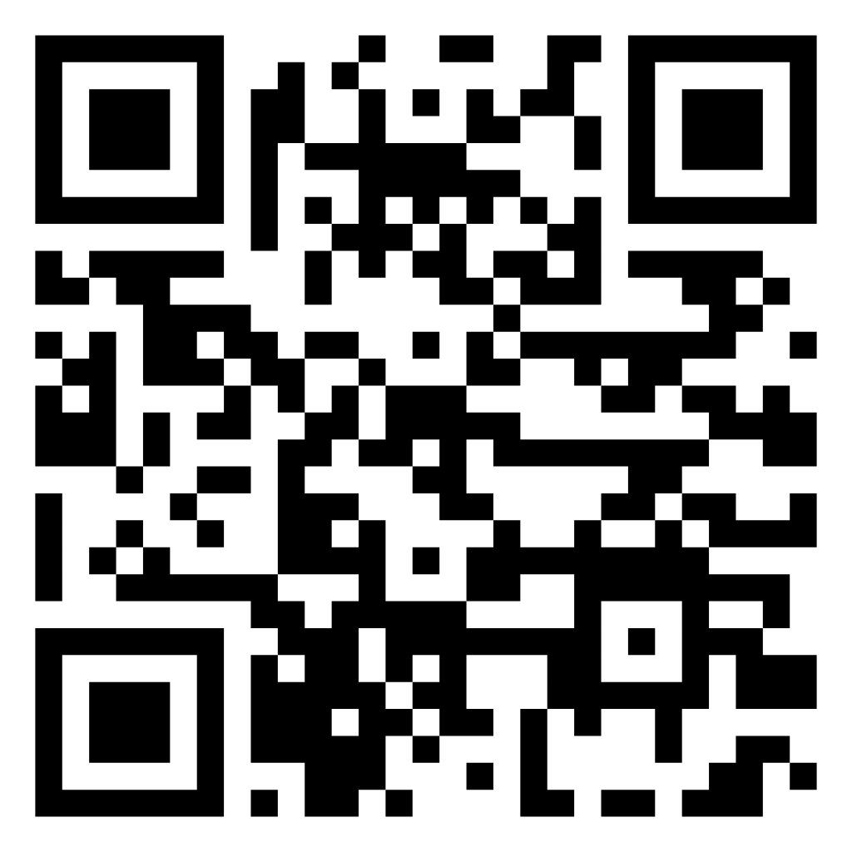
Thank you

